Slide 1
Priority Queues
Least-first-out queues

Slide 2
Priority Queues
Supports the following operations.
Insert element x.
Return min element.
Return and delete minimum element.
Decrease key of element x to k.
Applications.
Dijkstra's shortest path algorithm.
Prim's MST algorithm.
Event-driven simulation.
Huffman encoding.
Heapsort.
. . .
Notes:
Event driven simulation: generate random inter-arrival times between customers, generate random processing times per customer, Advance clock to next event, skipping intervening ticks

Slide 3
Priority queue
A stack is first in, last out (or last in, first out)
A queue is first in, first out
A priority queue is least-first-out
The “smallest” element is the first one removed
(You could also define a largest-first-out priority queue)
The definition of “smallest” is up to the programmer (for example, you might define it by implementing the Comparable interface)
If there are several “smallest” elements, the implementer must decide which to remove first
Remove any “smallest” element (don’t care which)
Remove the first one added / encountered

Slide 4
Priority queue example
A priority queue could be used to handle the jobs sent to the Computer Science Department's printer:
jobs sent by the department chair should be printed first
then jobs sent by professors
then those sent by graduate students
finally those sent by undergraduates
The values put into the priority queue would be the priority of the sender (e.g., using 4 for the chair, 3 for professors, 2 for grad students, and 1 for undergrads), and the associated information would be the document to print.

Slide 5
Priority queue example (cont’d)
Each time the printer is free, the job with the highest priority would be removed from the print queue and printed.
It is OK to have multiple jobs with the same priority; if there is more than one job with the same highest priority when the printer is free, you can process them in whatever order (e.g. normal queue order)

Slide 6
Java 5’s PriorityQueue API
In the java.util package. Example usage:
Queue<String> pq = new PriorityQueue<>();
boolean offer(E obj)
Inserts the specified element into this priority queue.
E peek()
Retrieves, but does not remove, the head of this queue, returning null if this queue is empty.
E poll()
Retrieves and removes the head of this queue (the "least" element), or null if this queue is empty.
int size()
Returns the number of elements in this collection.

Slide 7
Important note!!
Priority Queues are NOT internally sorted (you'll understand more about this when you write your own "min. heap" data structure, frequently the backbone of priority queues).
Printing a PriorityQueue (or using an Iterator) will NOT show / return elements in least-first-out (priority queue) order.
However, rest assured that when you retrieve an element from a Priority Queue (with poll), it will come out in least-first-order!

Slide 8
Important note!! (cont'd)
Queue<Integer> pq = new PriorityQueue<>();
pq.offer(4); pq.offer(2); pq.offer(8); pq.offer(1);
out.println(pq); //prints [1, 2, 8, 4] - not "PQ order"
for (Integer num : pq)
System.out.print(num + " ");
//prints 1 2 8 4 – not "PQ order"
while (!pq.isEmpty())
System.out.print(pq.poll() + " ");
//prints 1 2 4 8 - PQ order!

Slide 9
Evaluating implementations
When we choose a data structure, it is important to look at usage patterns
If we load an array once and do thousands of searches on it, we want to make searching fast—so we would probably sort the array
If we load a huge array and expect to do only a few searches, we probably don’t want to spend time sorting the array
For almost all uses of a queue (including a priority queue), we eventually remove everything that we add
Hence, when we analyze a priority queue, neither “add” nor “remove” is more important—we need to look at the timing for “add + remove”

Slide 10
Array implementations
A priority queue could be implemented as an unsorted array (with a count of elements)
Adding an element would take O(1) time (why?)
Removing an element would take O(n) time (why?)
Hence, adding and removing an element takes O(n) time
This is an inefficient representation
A priority queue could be implemented as a sorted array (again, with a count of elements)
Adding an element would take O(n) time (why?)
Removing an element would take O(1) time (why?)
Hence, adding and removing an element takes O(n) time
Again, this is inefficient

Slide 11
Linked list implementations
A priority queue could be implemented as an unsorted linked list
Adding an element would take O(1) time (why?)
Removing an element would take O(n) time (why?)
A priority queue could be implemented as a sorted linked list
Adding an element would take O(n) time (why?)
Removing an element would take O(1) time (why?)
As with array representations, adding and removing an element takes O(n) time
Again, these are inefficient implementations

Slide 12
Binary tree implementations
A priority queue could be represented as a (not necessarily balanced) binary search tree
Insertion times would range from O(log n) to O(n) (why?)
Removal times would range from O(log n) to O(n) (why?)
A priority queue could be represented as a balanced binary search tree
Insertion and removal could destroy the balance
We need an algorithm to rebalance the binary tree
Good rebalancing algorithms require only O(log n) time, but are complicated

Slide 13
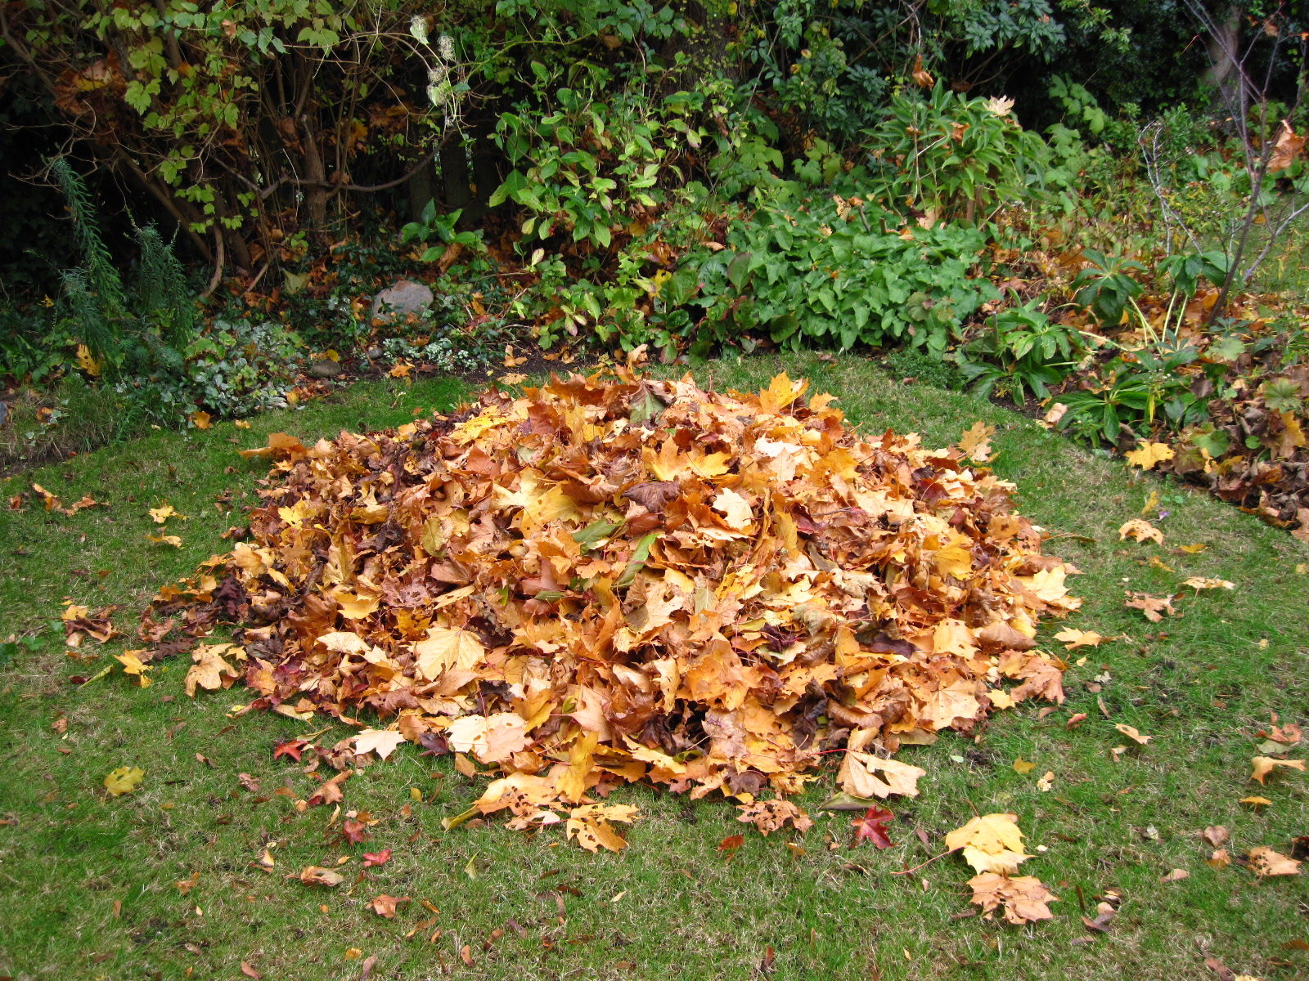
Heap implementation
A priority queue can be implemented as a heap

Slide 14
Binary Heap: Definition
Binary heap
Almost complete binary tree
filled on all levels, except last, where filled from left to right
Min-heap ordered
every child greater than (or equal to) parent
Max-heap ordered
every child less than (or equal to) parent
06
14
45
78
18
47
53
83
91
81
77
84
99
64

Slide 15
Binary Min-Heap: Properties
Properties.
Min element is in root.
Heap with N elements has height = ⎣log₂ N⎦.
N = 14 Height = 3
06
14
45
78
18
47
53
83
91
81
77
84
99
64

Slide 16
Array representation of a heap
3
0
12
6
1
2
18
14
8
3
4
5
lastIndex = 5
0 1 2 3 4 5 6 7 8 9 10 11 12
3
12
6
18
14
8
Left child of node i is 2*i + 1, right child is 2*i + 2
Unless the computation yields a value larger than lastIndex, in which case there is no such child
Parent of node i is (i – 1)/2
Unless i == 0

Slide 17
Using the heap
To add an element:
Increase lastIndex and put the new value there
Reheap the newly added node
This is called up-heap bubbling or percolating up
Up-heap bubbling requires O(log n) time
To remove an element:
Remove the element at location 0
Move the element at location lastIndex to location 0, and decrement lastIndex
Reheap the new root node (the one now at location 0)
This is called down-heap bubbling or percolating down
Down-heap bubbling requires O(log n) time
Thus, it requires O(log n) time to add and remove an element

Slide 18
Building a PriorityQueue (Insertion)
Queue<String> pq = new PriorityQueue<String>();
pq.offer(“B”);
pq.offer(“C”);
pq.offer(“F”);
pq.offer(“A”);
pq.add(“L”);
pq.add(“D”);
pq.add(“E”);
pq.add(“J”);

Slide 19
Building a PriorityQueue (Insertion)
Queue<String> pq = new PriorityQueue<String>();
pq.offer(“B”);
pq.offer(“C”);
pq.offer(“F”);
pq.offer(“A”);
pq.add(“L”);
pq.add(“D”);
pq.add(“E”);
pq.add(“J”);
Min Heap
B

Slide 20
Building a PriorityQueue (Insertion)
Queue<String> pq = new PriorityQueue<String>();
pq.offer(“B”);
pq.offer(“C”);
pq.offer(“F”);
pq.offer(“A”);
pq.add(“L”);
pq.add(“D”);
pq.add(“E”);
pq.add(“J”);
Min Heap
B
C

Slide 21
Building a PriorityQueue (Insertion)
Queue<String> pq = new PriorityQueue<String>();
pq.offer(“B”);
pq.offer(“C”);
pq.offer(“F”);
pq.offer(“A”);
pq.add(“L”);
pq.add(“D”);
pq.add(“E”);
pq.add(“J”);
Min Heap
B
C
F

Slide 22
Building a PriorityQueue (Insertion)
Queue<String> pq = new PriorityQueue<String>();
pq.offer(“B”);
pq.offer(“C”);
pq.offer(“F”);
pq.offer(“A”);
pq.add(“L”);
pq.add(“D”);
pq.add(“E”);
pq.add(“J”);
Min Heap
B
C
F
A

Slide 23
Building a PriorityQueue (Insertion)
Queue<String> pq = new PriorityQueue<String>();
pq.offer(“B”);
pq.offer(“C”);
pq.offer(“F”);
pq.offer(“A”);
pq.add(“L”);
pq.add(“D”);
pq.add(“E”);
pq.add(“J”);
Min Heap
B
A
F
C

Slide 24
Building a PriorityQueue (Insertion)
Queue<String> pq = new PriorityQueue<String>();
pq.offer(“B”);
pq.offer(“C”);
pq.offer(“F”);
pq.offer(“A”);
pq.add(“L”);
pq.add(“D”);
pq.add(“E”);
pq.add(“J”);
Min Heap
A
B
F
C

Slide 25
Building a PriorityQueue (Insertion)
Queue<String> pq = new PriorityQueue<String>();
pq.offer(“B”);
pq.offer(“C”);
pq.offer(“F”);
pq.offer(“A”);
pq.add(“L”);
pq.add(“D”);
pq.add(“E”);
pq.add(“J”);
Min Heap
A
B
F
C
L

Slide 26
Building a PriorityQueue (Insertion)
Queue<String> pq = new PriorityQueue<String>();
pq.offer(“B”);
pq.offer(“C”);
pq.offer(“F”);
pq.offer(“A”);
pq.add(“L”);
pq.add(“D”);
pq.add(“E”);
pq.add(“J”);
Min Heap
A
B
F
C
L
D

Slide 27
Building a PriorityQueue (Insertion)
Queue<String> pq = new PriorityQueue<String>();
pq.offer(“B”);
pq.offer(“C”);
pq.offer(“F”);
pq.offer(“A”);
pq.add(“L”);
pq.add(“D”);
pq.add(“E”);
pq.add(“J”);
Min Heap
A
B
D
C
L
F

Slide 28
Building a PriorityQueue (Insertion)
Queue<String> pq = new PriorityQueue<String>();
pq.offer(“B”);
pq.offer(“C”);
pq.offer(“F”);
pq.offer(“A”);
pq.add(“L”);
pq.add(“D”);
pq.add(“E”);
pq.add(“J”);
Min Heap
A
B
D
C
L
F
E

Slide 29
Building a PriorityQueue (Insertion)
Queue<String> pq = new PriorityQueue<String>();
pq.offer(“B”);
pq.offer(“C”);
pq.offer(“F”);
pq.offer(“A”);
pq.add(“L”);
pq.add(“D”);
pq.add(“E”);
pq.add(“J”);
Min Heap
A
B
D
C
L
F
E
J

Slide 30
Building a PriorityQueue (Insertion)
Queue<String> pq = new PriorityQueue<String>();
pq.offer(“B”);
pq.offer(“C”);
pq.offer(“F”);
pq.offer(“A”);
pq.add(“L”);
pq.add(“D”);
pq.add(“E”);
pq.add(“J”);
Min Heap
A
B
D
C
L
F
E
J

Slide 31
Binary Heap: Delete Min
Delete minimum element from heap.
Exchange root with rightmost leaf.
Bubble root down until it's heap ordered.
power struggle principle: better subordinate is promoted
06
14
42
78
18
47
45
83
91
81
77
84
99
64
53

Slide 32
Binary Heap: Delete Min
Delete minimum element from heap.
Exchange root with rightmost leaf.
Bubble root down until it's heap ordered.
power struggle principle: better subordinate is promoted
06
14
42
78
18
47
45
83
91
81
77
84
99
64
53

Slide 33
Binary Heap: Delete Min
Delete minimum element from heap.
Exchange root with rightmost leaf.
Bubble root down until it's heap ordered.
power struggle principle: better subordinate is promoted
53
14
42
78
18
47
45
83
91
81
77
84
99
64

Slide 34
Binary Heap: Delete Min
Delete minimum element from heap.
Exchange root with rightmost leaf.
Bubble root down until it's heap ordered.
power struggle principle: better subordinate is promoted
exchange with left child
53
14
42
78
18
47
45
83
91
81
77
84
99
64

Slide 35
Binary Heap: Delete Min
Delete minimum element from heap.
Exchange root with rightmost leaf.
Bubble root down until it's heap ordered.
power struggle principle: better subordinate is promoted
exchange with right child
14
53
42
78
18
47
45
83
91
81
77
84
99
64

Slide 36
Binary Heap: Delete Min
Delete minimum element from heap.
Exchange root with rightmost leaf.
Bubble root down until it's heap ordered.
power struggle principle: better subordinate is promoted
O(log N) operations.
stop: heap ordered
14
18
42
78
53
47
45
83
91
81
77
84
99
64

Slide 37
Improving Heap Insert Time
What if all N elements are available upfront?
To build a heap with N elements
Default (Insertion) method takes O(N log N) time
We will now see a new method called buildHeap() that will take O(N) time – (optimal)

Slide 38
Building a Heap
Construct heap from initial set of N items
Solution 1: Insertion
Perform N inserts
O(N log₂ N) worst-case
Solution 2: buildHeap()
Randomly populate initial heap with structure property
Perform a percolate-down from each internal node (H[size/2] to H[1])
To take care of heap order property

Slide 39
BuildHeap()
// given an unsorted array A, make A a heap
BuildHeap(A)
{
heap_size(A) = length(A);
for (i = ⎣length[A]/2⎦ downto 1)
Heapify(A, i); //recursively swap elements
}

Slide 40
Heap Operations: Heapify()
Heapify(A, i)
{ // precondition: subtrees rooted at l and r are heaps
l = Left(i); r = Right(i);
if (l <= heap_size(A) && A[l] > A[i])
largest = l;
else
largest = i;
if (r <= heap_size(A) && A[r] > A[largest])
largest = r;
if (largest != i) {
Swap(A, i, largest);
Heapify(A, largest);
}
} // postcondition: subtree rooted at i is a heap
Among A[l], A[i], A[r],
which one is largest?
If violation, fix it.

Slide 41
BuildHeap() Example with Max-Heap
Work through example A = {4, 1, 3, 2, 16, 9, 10, 14, 8, 7}
4
1
3
2
16
9
10
14
8
7
A =
4
1
3
2
16
9
10
14
8
7

Slide 42
BuildHeap() Example with Max-Heap
Leaves are all
valid heaps (implicitly)
Work through example A = {4, 1, 3, 2, 16, 9, 10, 14, 8, 7}
4
1
3
2
16
9
10
14
8
7
A =
4
1
3
2
16
9
10
14
8
7

Slide 43
BuildHeap() Example with Max-Heap
Leaves are all
valid heaps (implicitly)
Work through example A = {4, 1, 3, 2, 16, 9, 10, 14, 8, 7}
So let us look at each internal node, from bottom to top, and fix if necessary
4
1
3
2
16
9
10
14
8
7
A =
4
1
3
2
16
9
10
14
8
7

Slide 44
BuildHeap() Example with Max-Heap
4
1
3
2
16
9
10
14
8
7
A =
4
1
3
2
16
9
10
14
8
7

Slide 45
BuildHeap() Example with Max-Heap
4
1
3
2
16
9
10
14
8
7
A =
4
1
3
2
16
9
10
14
8
7

Slide 46
BuildHeap() Example with Max-Heap
4
1
3
14
16
9
10
2
8
7
A =
4
1
3
14
16
9
10
2
8
7

Slide 47
BuildHeap() Example with Max-Heap
4
1
3
14
16
9
10
2
8
7
A =
4
1
3
14
16
9
10
2
8
7

Slide 48
BuildHeap() Example with Max-Heap
4
1
10
14
16
9
3
2
8
7
A =
4
1
10
14
16
9
3
2
8
7

Slide 49
BuildHeap() Example with Max-Heap
4
1
10
14
16
9
3
2
8
7
A =
4
1
10
14
16
9
3
2
8
7

Slide 50
BuildHeap() Example with Max-Heap
4
16
10
14
1
9
3
2
8
7
A =
4
16
10
14
1
9
3
2
8
7

Slide 51
BuildHeap() Example with Max-Heap
4
16
10
14
7
9
3
2
8
1
A =
4
16
10
14
7
9
3
2
8
1

Slide 52
BuildHeap() Example with Max-Heap
4
16
10
14
7
9
3
2
8
1
A =
4
16
10
14
7
9
3
2
8
1

Slide 53
BuildHeap() Example with Max-Heap
16
4
10
14
7
9
3
2
8
1
A =
16
4
10
14
7
9
3
2
8
1

Slide 54
BuildHeap() Example with Max-Heap
16
14
10
4
7
9
3
2
8
1
A =
16
14
10
4
7
9
3
2
8
1

Slide 55
BuildHeap() Example with Max-Heap
16
14
10
8
7
9
3
2
4
1
A =
16
14
10
8
7
9
3
2
4
1

Slide 56
Comments
A priority queue is a data structure that is designed to return elements in order of priority
Efficiency is usually measured as the sum of the time it takes to add and to remove an element
Simple implementations take O(n) time
Heap implementations take O(log n) time
Balanced binary tree implementations take O(log n) time
Binary tree implementations, without regard to balance, can take O(n) (linear) time
Thus, for any sort of heavy-duty use, heap or balanced binary tree implementations are better

Slide 57
Java 5 java.util.PriorityQueue
Java 5 finally has a PriorityQueue class, based on heaps
Has redundant methods because it implements two similar interfaces
PriorityQueue<E> queue = new PriorityQueue<E>();
Uses the natural ordering of elements (that is, Comparable)
There is another constructor that takes a Comparator argument
boolean add(E o) – from the Collection interface
boolean offer(E o) – from the Queue interface
E peek() – from the Queue interface
boolean remove(Object o) – from the Collection interface
E poll() – from the Queue interface (returns null if queue is empty)
void clear()
int size()

